Slide 1

No-Show Prediction Model
Designed by Alexander Donald

Slide 2
Goal
Initial Goal: Predict whether a slot will go unfilled
This seemed too broad to predict well
Current Goal: Predict the probability of a given filled appointment slot for internal medicine between the hours of 7am and 5pm being a ‘No-Show’ based on appointment characteristics such as time, day, patient demographics, etc
No-Show: Listed in Athena as a ‘No-Show, No-Call’ meaning that the patient did not show up to the appointment or cancel the appointment ahead of time
Filled Appointment Slot: An appointment slot that is booked with a patient (not open)
Probability: A number between 0 and 1 that represents how likely an appointment slot is going to be a no-show

Slide 3
About the Data
Features:
DAYOFWEEK
MONTH
APPOINTMENTSTARTTIME_HOUR
SPECIALTY
AGE_CATEGORY
SEX
LANGUAGE
ETHNICITY
RACE
MARITALSTATUS
SMSOPTIN
previous_noshow (Count of previous no-shows)
DATE_DIFF_CATEGORY (difference between scheduled and appointment dates
Dependent Variable:
slot_noShow

Slide 4
Methods
Model Choice:
Logistic Regression classifier from Python’s scikit learn library
Implements regularized logistic regression to predict a value between 0 and 1 based on the set of features to predict the probability of a no-show
Model1 => Logistic regression classifier using class_weight=balanced to account for imbalanced data
Model2 => Logistic regression classifier using SMOTE re-sampled data to account for imbalance in data
Model Parameters:
solver=‘saga’ - uses the ‘saga’ algorithm in the optimization problem
class_weight='balanced’ - weights the punishment of wrong predictions by the inverse of class distribution (**Only used Model1**)
penalty=‘l1’ - add L1 penalty to reduce coefficients of uninformative features to 0
verbose = 1 - displays model progress

Slide 5
Sampling (Model2)
Techniques
SMOTE = Synthetic Minority Oversampling Technique
RandomUnderSampler = Under samples majority class to even out class distribution
Both contained in Python’s imbalanced-learn library
Use a combination of oversampling and under sampling to even out class distribution
Allows the linear regression to treat majority and minority classes with equal weight since the count of examples is now similar

Slide 6
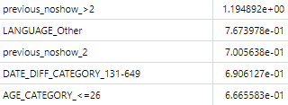
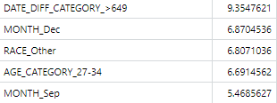
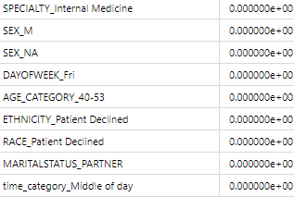
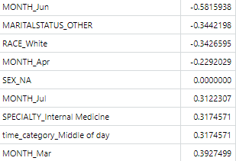
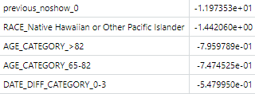
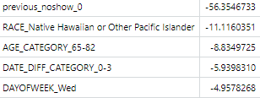
Feature Coefficients
Model2
Model1
Top 5 highest (increase no-show prob)
Zeroed out or close to 0 (due to L1 regularization)
Top 5 lowest (decrease no-show prob)

Slide 7
Results (Model1)
Training:
Threshold set to .2 (prediction above .2 predicts no-show)
Scores:
Accuracy: 0.85
ROC Area Under Curve: 0.88
How good model is at distinguishing between classes
Recall: .91
The number of instances which the model correctly identified as relevant out of the total relevant instances
Precision: .22
The number of instances that are relevant, out of the total instances the model retrieved
F1 score: 0.35
Prediction Breakdown
True Positives: 4,766
False Positives: 16,971
True Negatives: 95,124
False Negatives: 453

Slide 8
Results (Model2)
Training:
Threshold set to .3 (prediction above .3 predicts no-show)
Scores:
Accuracy: 0.83
ROC Area Under Curve: 0.91
How good model is at distinguishing between classes
Recall: .99
The number of instances which the model correctly identified as relevant out of the total relevant instances
Precision: .21
The number of instances that are relevant, out of the total instances the model retrieved
Low due to the high number of false positives compared to the number of true positives (class imbalance skews this number)
F1 score: 0.35
Prediction Breakdown
True Positives: 5,194
False Positives: 19,543
True Negatives: 92,552
False Negatives: 25

Slide 9
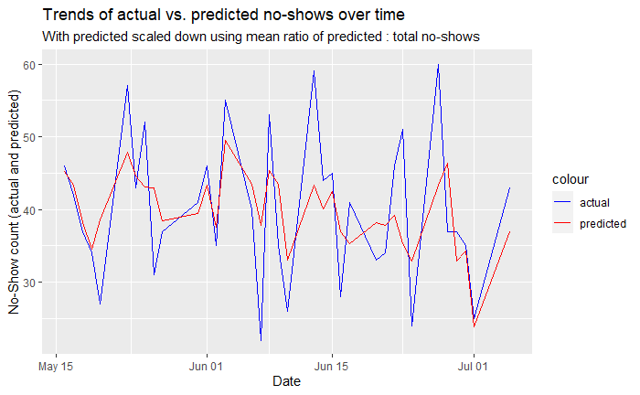
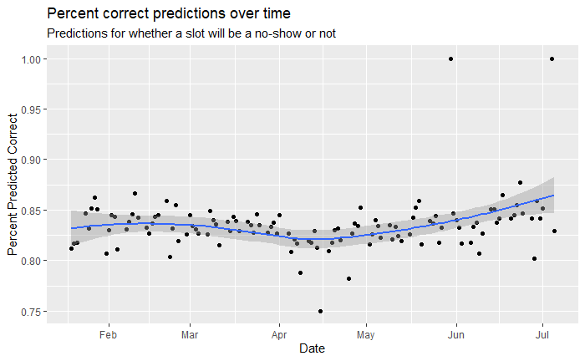
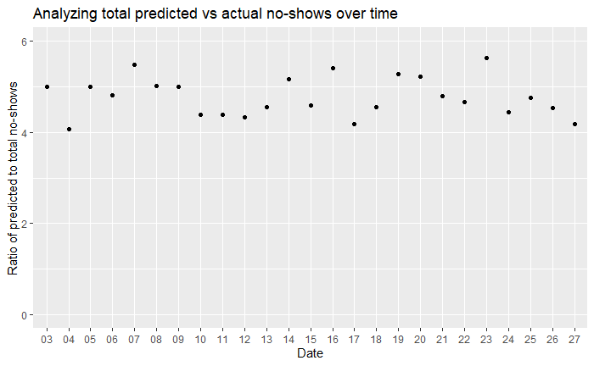
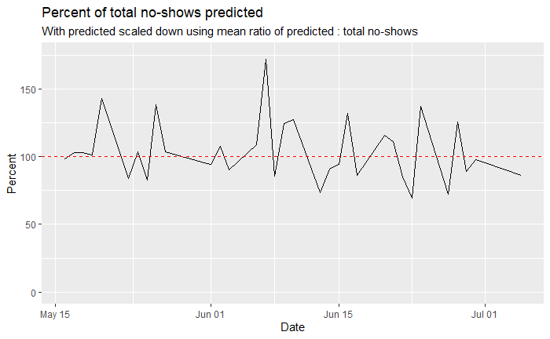
Analysis (Model2)
Model Accuracy
Avg ratio (trailing 4 months) of total predicted no-shows/day : actual no-shows/day = 4.87 : 1
Use this factor to scale down predictions to get a better per day value
Off by an average of only 6.24 no-shows/day or 16%
Ratio of total predicted to actual no-shows

Slide 10
Conclusion
Real-World Use
Based on the difference between the scores of PR-AUC and F1 for the trained models compared to a random model, the model has a solid amount of learned prediction power
The main concern is the high number of not no-shows that are predicted as no-shows
Could lead to overscheduling problems
Possible solution(s) to use the model's intelligence but decrease the impact of wrong predictions include:
Predicting a total number of no-shows per day rather than at a slot level
Improving the model
Engineering features that help distinguish between patients that will no-show and those who won’t
Increasing the specificity of the data such as department location or even provider could eliminate noise in the data
Testing other types of prediction models such as Random Forest or K-Nearest Neighbors
Fine-tuning hyperparameters further

